Slide 1
Restorative Church
A Post-NACRJ Conference Gathering
June 2019
Ted Lewis

Slide 2
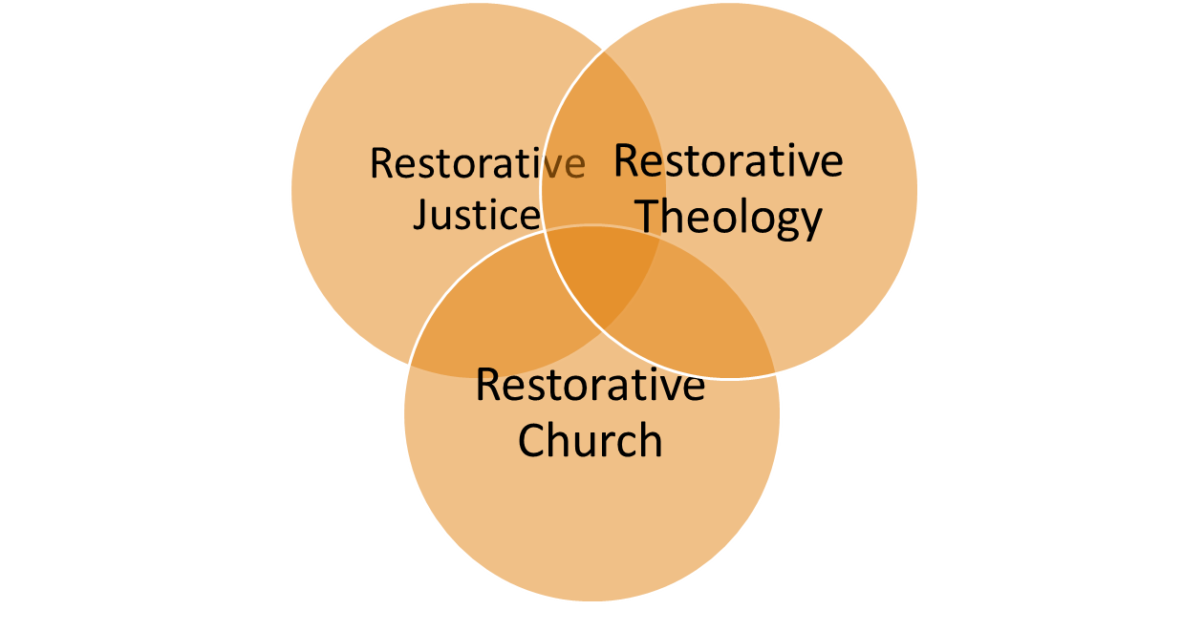
Exploring the Intersections

Slide 3
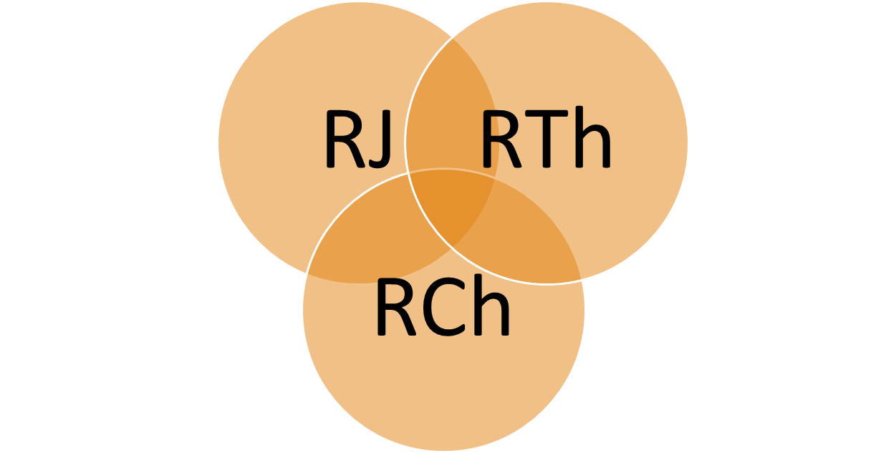
Exploring the Intersections
(webinar last October 2016)

Slide 4
Exploring the Intersections
      1. What can theologians gain from RJ
      practitioners?
2. What can RJ movement leaders gain
from restorative theologians?
3. What can church leaders gain from RJ
practitioners or restorative theologians?

Slide 5
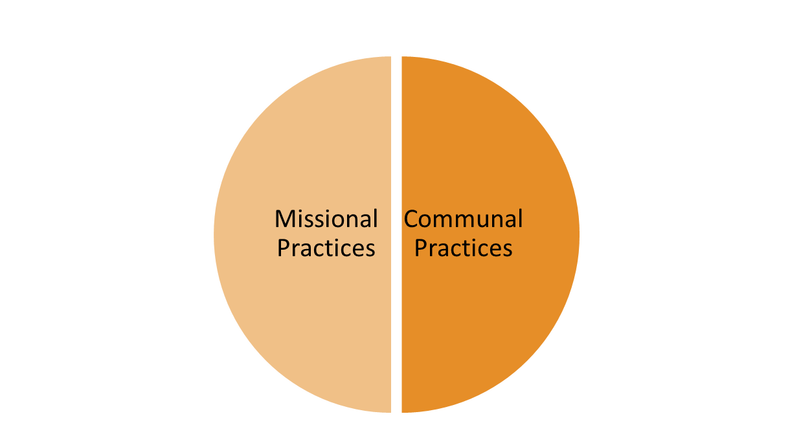
Restorative Church Practices

Slide 6
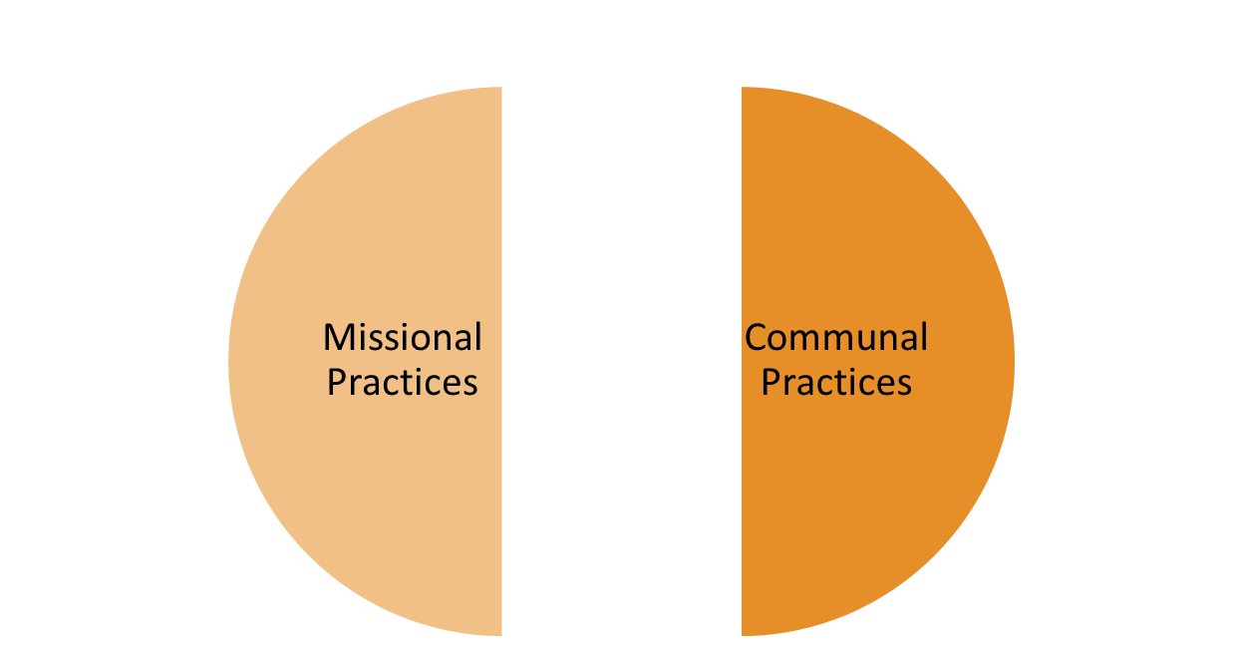
Restorative Church Practices
Inter-
Tribal
Practices

Slide 7
Restorative Theology
Connection points to Restorative Justice:
Biblical meta-narrative of restoration
OT Hebrew terms (righteousness, peace,…)
Atonement theory
Repentance and forgiveness dynamics
Eschatological (future-leaning) dimension

Slide 8
Restorative Theology
Other biblical touch-points:
Power and centrality of story-telling
Dialogue as sacred conversation
Sensitivity to the plight of victims
Humanity and dignity of offenders
Paradox of vulnerability leading to life

Slide 9
Restorative Theology
“God’s justice is a saving, healing, restorative justice, because the God to whom justice belongs is the Creator God who has yet to complete his original plan for creation…”
-- N. T. Wright, Evil and the Justice of God, 2013

Slide 10
Integrity of Means and End
“And the harvest of righteousness (dikaiosunes; justice) is sown in peace by those who make peace.”
James 3:18

Slide 11
Restorative History
1975 to 1985 -- church-based VORPs grow movement
1985 to 1995 -- RJ broadens out; indigenous resonance
1995 to 2005 -- RJ and theological resonance begins
2005 to 2015 -- church practices associated with RJ

Slide 12
Restorative History
1975 to 1985 -- church-based VORPs grow movement
1985 to 1995 -- RJ broadens out; indigenous resonance
1995 to 2005 -- RJ and theological resonance begins
2005 to 2015 -- church practices associated with RJ
Question: If the foundations of restorative justice owes much to the church practices of a Christian peace-church tradition, why are most churches today not tuned into making restorative practices a key part of church life?

Slide 13
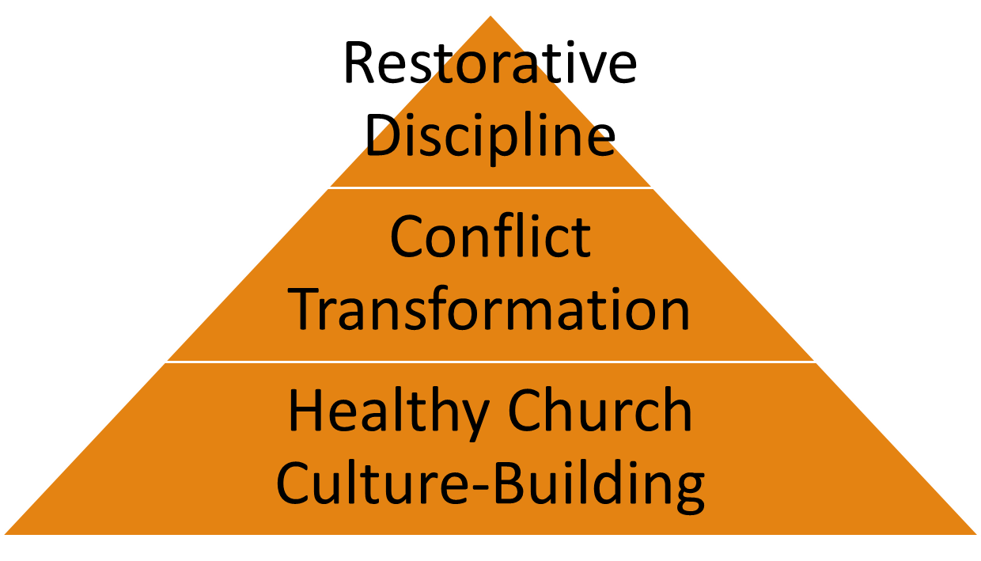
Restorative Church Practices

Slide 14
Our Workshop Outline
1. Biblical / Theological Ties to Restorative Justice – Chris
2. Ecclesial Foundations to the Start of Restorative Justice – Tom
3. Mapping Out Restorative Practices for Church Groups – Ted

Slide 15
To learn more about the
Restorative Church project
restorativechurch.org
Ted Lewis
tedlewis76@gmail.com
715-205-5945

